Slide 1
salaryball
Baseball player valuations have changed
Are their salaries following suit?

Slide 2
Alex’s Background
Master’s degree in Business Administration
Introduced to data science through a business analytics class
And advanced analysis of baseball
I’m passionate about data science because it feeds my curiosity and need to know “why?” I’m also fascinated by how understanding at this level can help dictate the direction of society as a whole

Slide 3
Anthony’s Background
Bachelor’s degree in Communications and Marketing
Background in project management for education programs with NASA and in higher education
Data science is fascinating to me because it has the capacity to change just about everything it touches, it has the power to steer organizational decisions and change the way entire systems function

Slide 4
Project Background
Oakland A’s and the popularization of sabermetrics
Initially, sabermetric principles were used to acquire discounted talent
Sabermetrics = empirical analysis
One assumption was that as player evaluation focused on player performance metrics, contracts should have followed suit
How have player valuations changed?
How have teams strategized and paid out salaries over time?
Can we quantify the effect of analytics by analyzing player salaries?

Slide 5
Methods
Used data from 2 main sources:
Lahman’s Baseball Database & Baseball Reference’s WAR data
Lahman’s Database
Compiled by Sean Lahman, an award-winning reporter & sports statistician
The preeminent data source for baseball analysis
Consists of 24 different datasets on various baseball-related topics
We used: Batting, Pitching, Fielding, Salaries, People, & Teams

Slide 6
Methods
Datasets contained over 100,000 entries
Each entry represents one player’s performance for one season
Salary data only for 1985-2016
Subset data to create two different data frames for 1995-1999 & 2015-2019
Pre-sabermetric revolution and post-sabermetric revolution

Slide 7
Methods
BattingA: 6,363 entries
BattingB: 7,566 entries
warBatA: 3,070 entries
warPitchB: 4,294 entries

Slide 8
Methods
Baseball Reference Batting/Pitching WAR datasets
Compiled by Baseball Reference, an online encyclopedia which provides detailed statistics throughout the history of organized baseball
Consists of 2 separate datasets, one for batting metrics, one for pitching metrics
Contains new, advanced metrics such as Wins Above Replacement, OPS+, ERA+

Slide 9
Methods
Datasets contained over 100,000 entries
Each entry represents one player’s performance for one season
Subset data to create two different data frames for 1995-1999 & 2015-2019
warBatA, warBatB, warPitchA, & warPitchB
warBatA: 6,357 entries
warBatB: 7,253 entries
warPitchA: 3,067 entries
warPitchB: 4,293 entries

Slide 10
Methods
Used R to subset, wrangle, and join datasets
Recoded variables to be consistent within datasets
Recoded variables to be categorical (for random forests)
Dropped unnecessary variables
Subset all datasets to only contain data for 1995-1999 & 2015-2019
Created new datasets to run analyses on specific portions of the population (4+ WAR, specific ages etc.)
Joined Batting/warBat, Pitching/warPitch, Batting/Salaries, & Pitching/Salaries

Slide 11
Methods
Ran linear regression & ANOVAs in R
For important variables such as salary, WAR, age, plate appearances, innings pitched, etc.
Ran random forests and created correlation matrices in Python
Created visualizations in Tableau

Slide 12
Results
Here’s what we found…

Slide 13
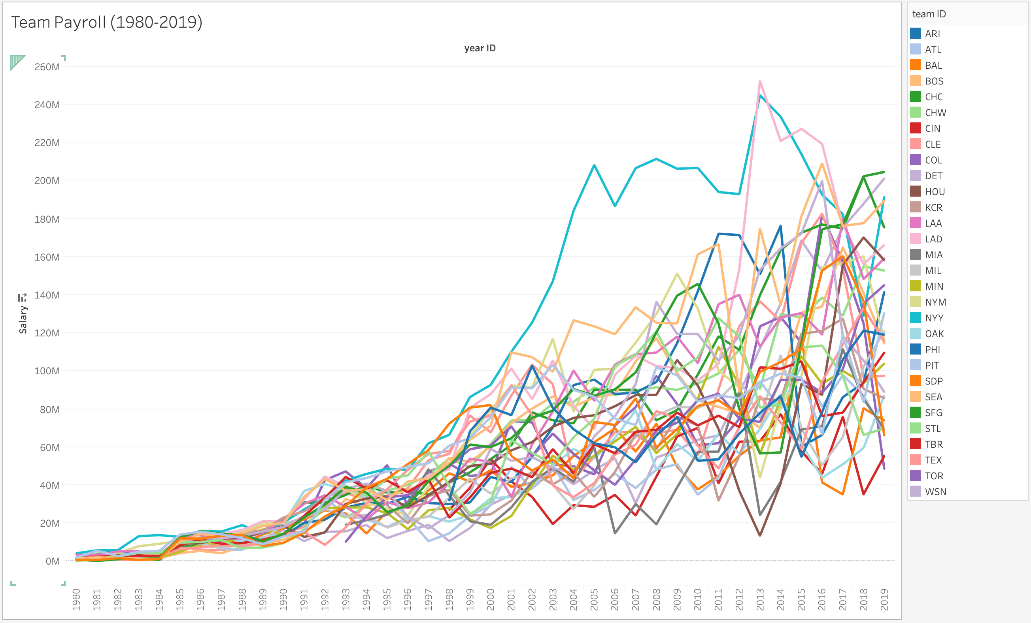
Notice drastic increase starting approximately 1990

Slide 14
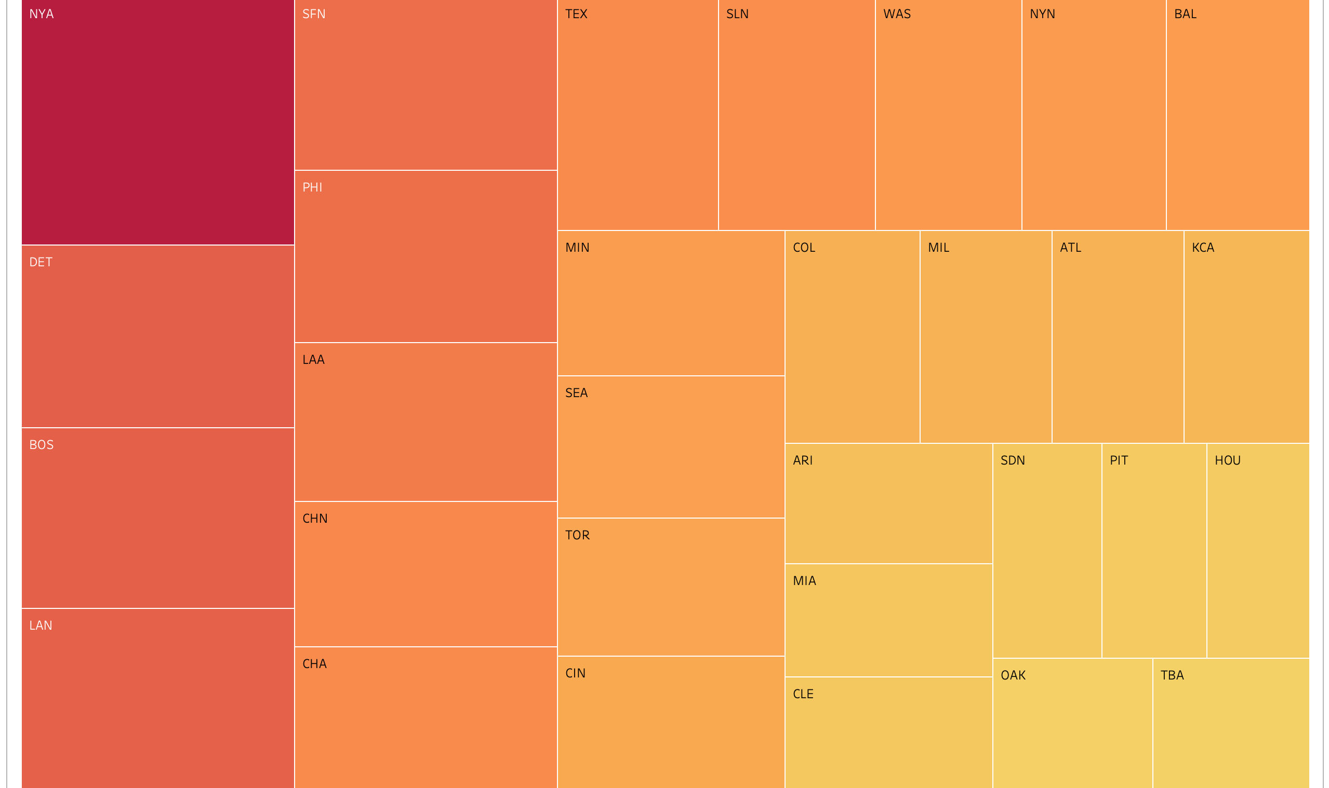
The Yankees Spend the More than any other team

Slide 15
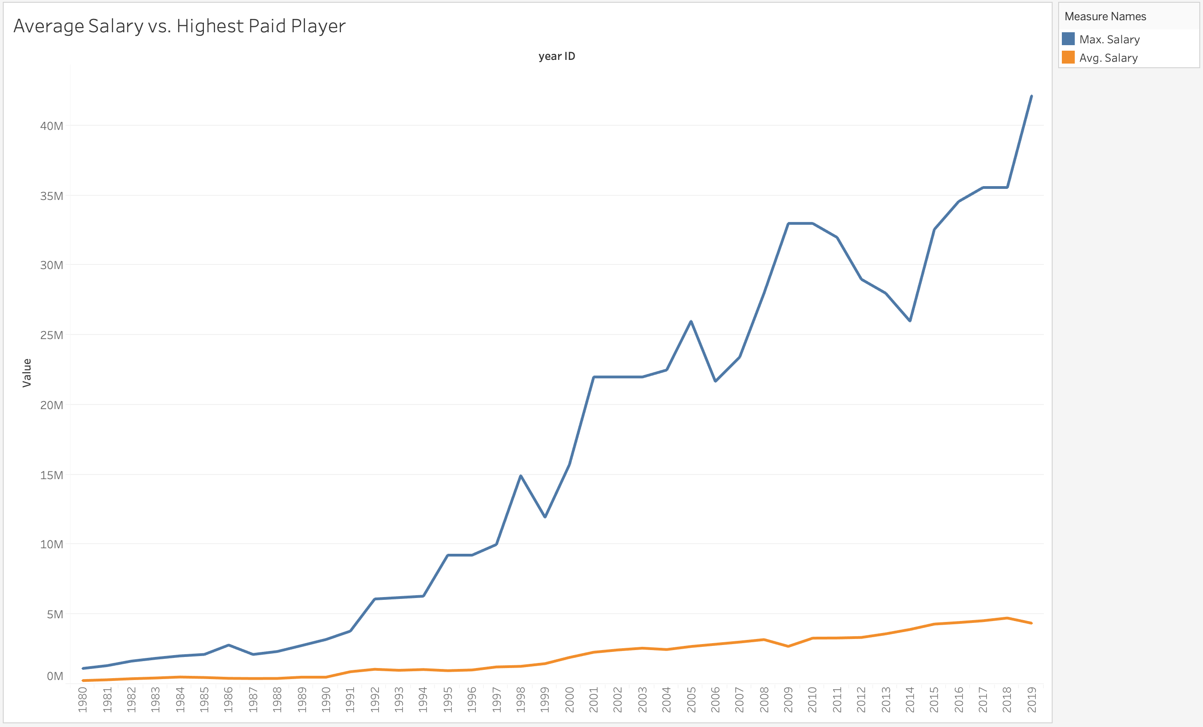
Same phenomenon visible here, as drastic uptick begins ~1990

Slide 16
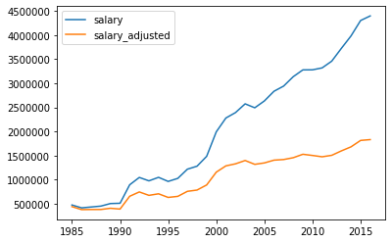
Player Salaries are increasing over time at a rate much higher than inflation can explain by itself
There is a significant difference year to year in salaries both in the 90s and the modern era
1995-2000
P-value = 1.1e-12
2015-2019
P-value = 3.383-09
Average Salary vs. Inflation-Adjusted Average Salary

Slide 17
The eve of WAR
Wins Above Replacement
A metric used to measure the overall contribution which a player provides to his team
A product of the sabermetric revolution
It should better correlate with salary now than it did in the 90s
Instead, the correlation was lower for modern day salaries
WAR is a complex metric with many different components, so maybe actual correlation is simply lost in the intricacy?
No significant finding for other advanced metrics

Slide 18
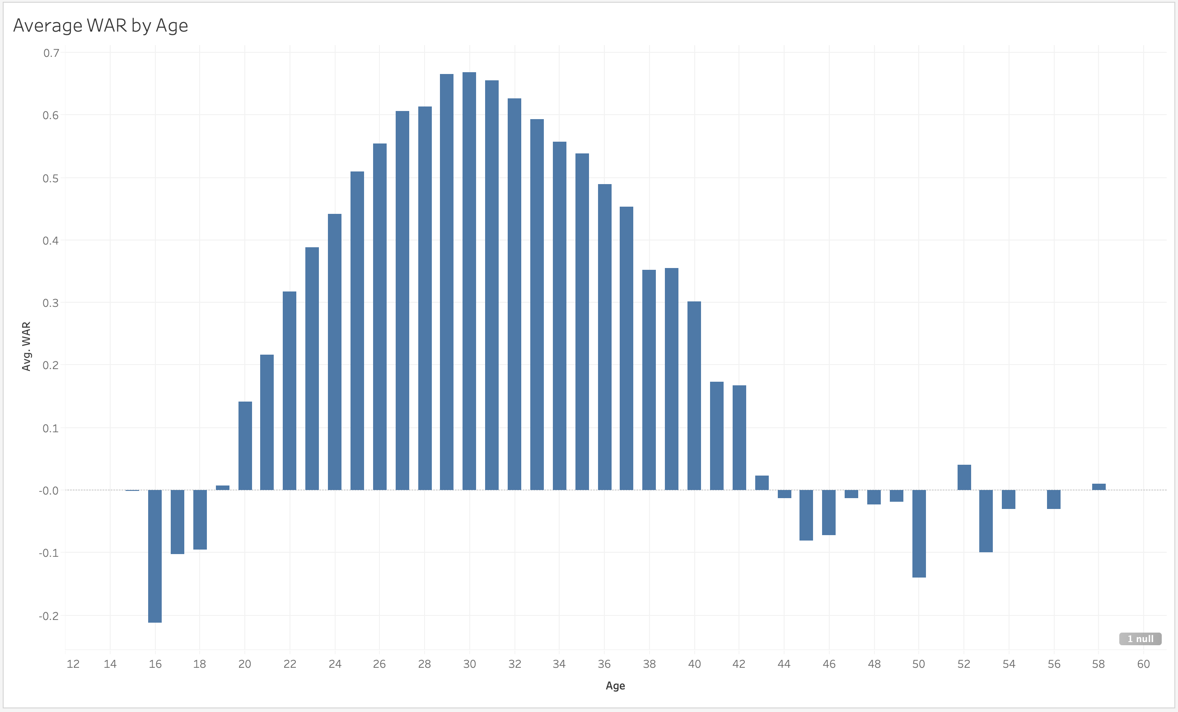

Slide 19
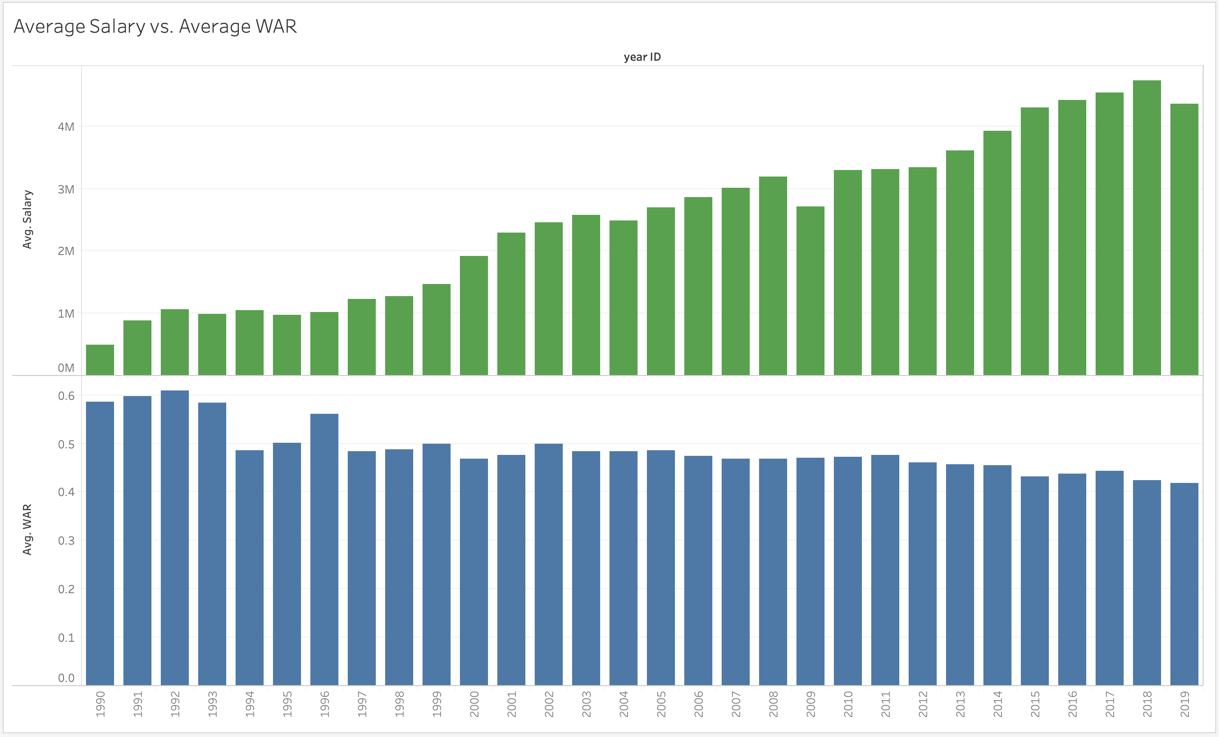
One surprising finding; a players performance on the field does not seem to automatically mean a player will be paid more.

Slide 20
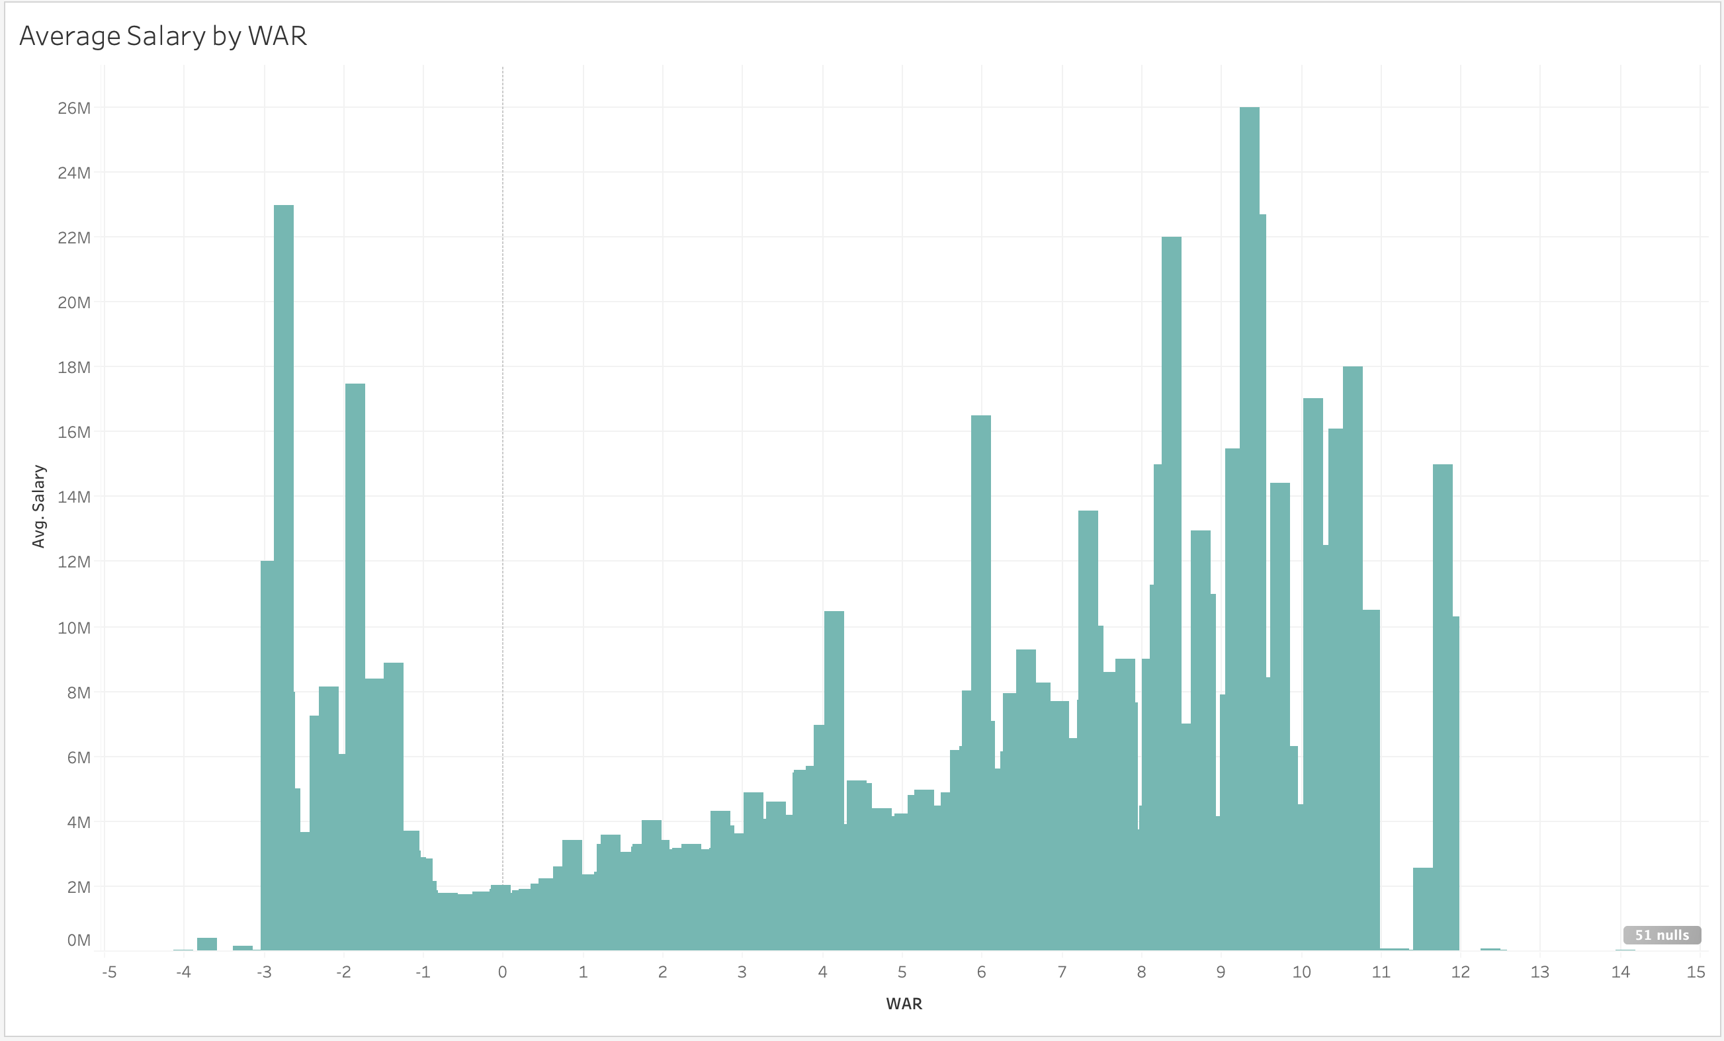
Not much correlation between salary and WAR

Slide 21
WAR: What is it good for?
This made us question how prevalent these concepts actually are in baseball today
Created linear regression models to determine the relationship between WAR and both plate appearances (for batters) and innings pitched (for pitchers)
WAR was a very significant factor for both, but not much change between the 90s and modern day

Slide 22
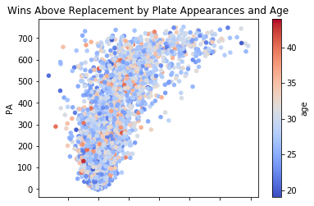
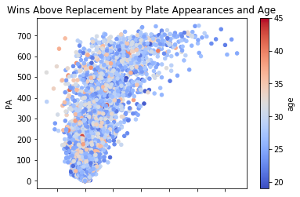
1995-1999
2015-2019

Slide 23
Influence of traditional stats
We thought that one way to see how player valuations have changed was to examine the relationship between both PA and IP and more traditional stats
Home runs, runs batted in, strikeouts, earned run average, and pitching wins
Our analysis showed a clear shift away from these stats
This supports the idea that advanced metrics have altered the way players are valued

Slide 24
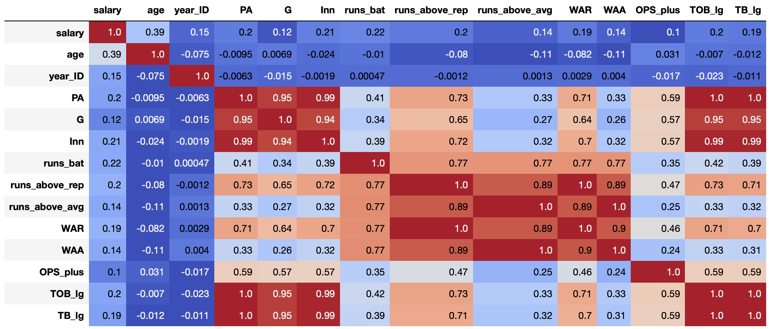
Clear lack of correlating variables for salary

Slide 25
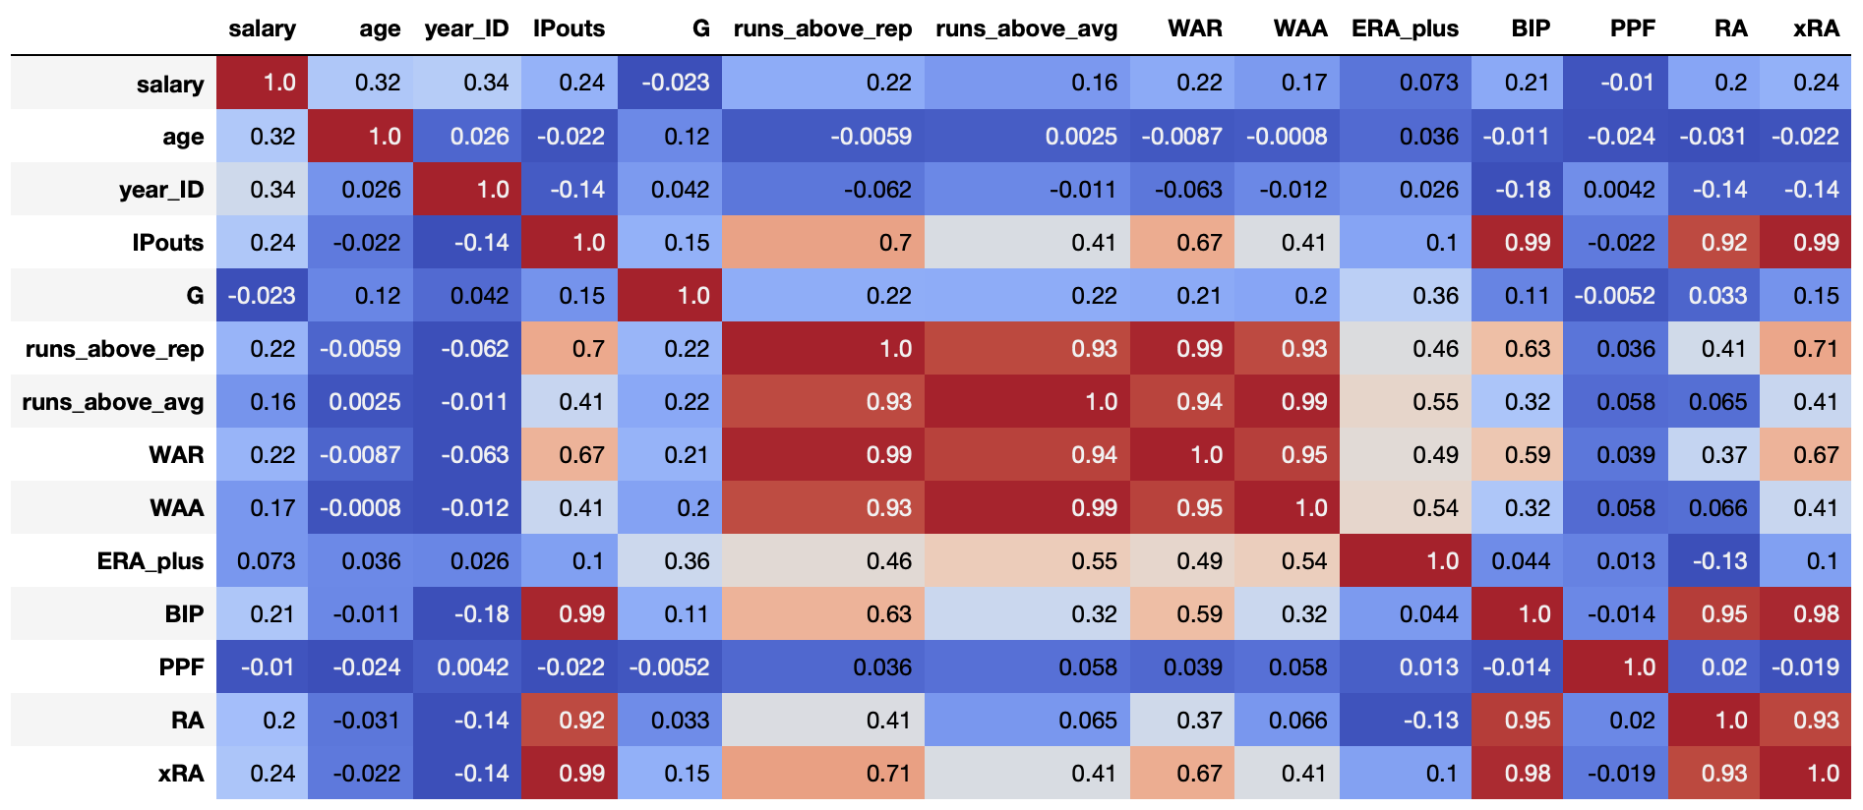
Year far more correlated in pitchers vs. position players

Slide 26
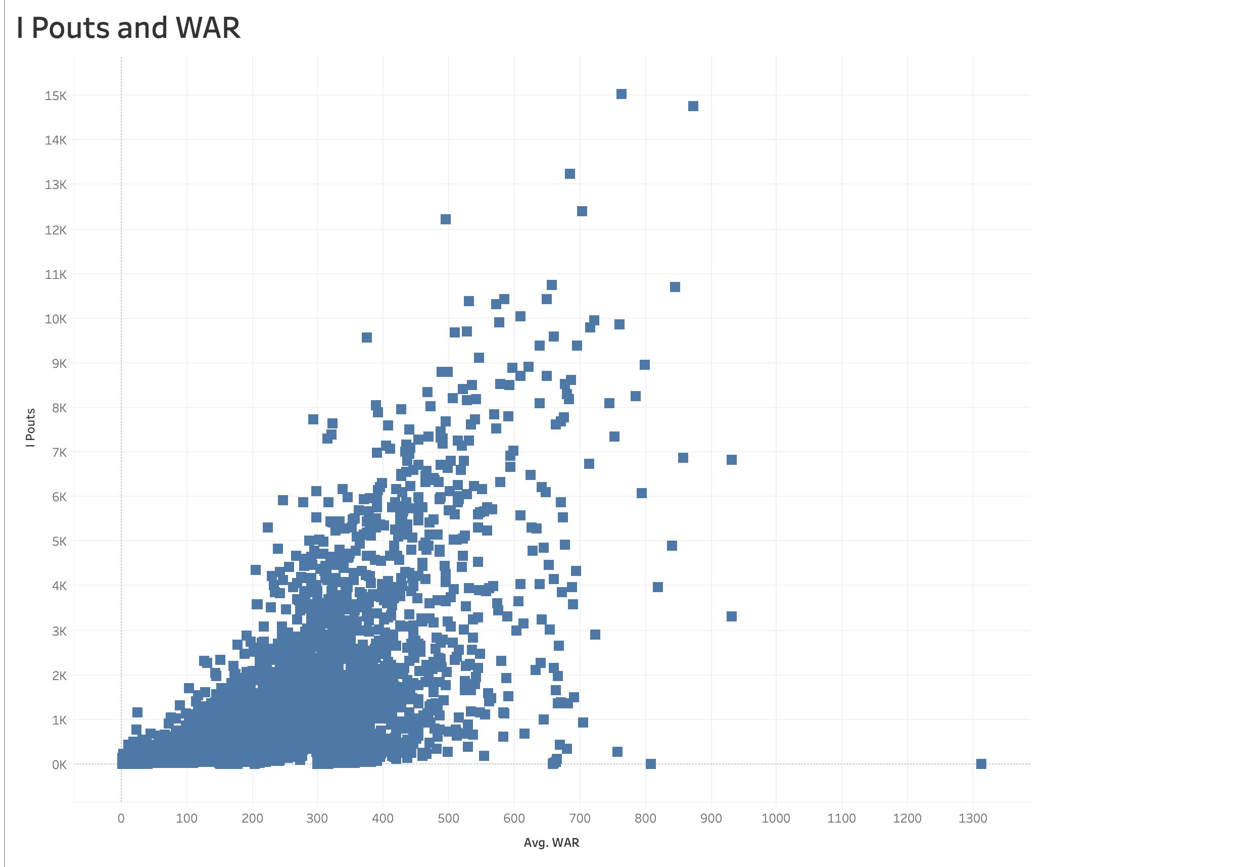
Looking Deeper at Pitchers IPouts and WAR stats
IPouts or Inning Pitched with an Out
WAR and Ipouts
Regression Analysis Adjusted R-sqaured .42 IPouts account for 40% of the factors that go into WAR

Slide 27
What influences salary?
Nothing influences salary as much as factors of time
Factors such as:
Age
Plate appearances
Innings pitched
As players increase their opportunities for play, they increase their likelihood for higher pay

Slide 28
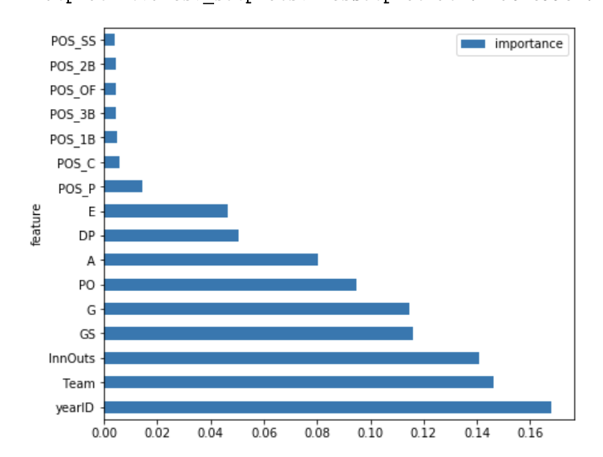
Year, Team, Innouts
Feature Importance of Pitching data

Slide 29
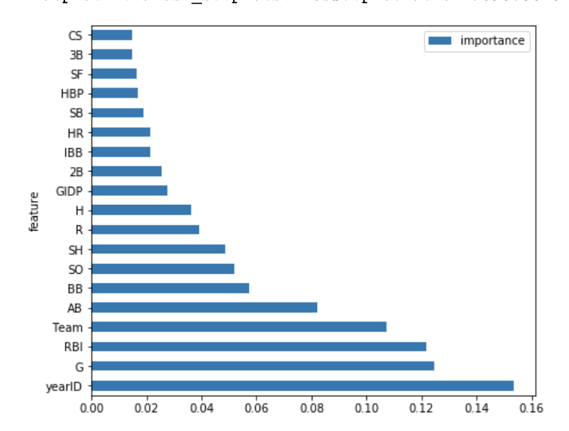
Year, Games Played, Team
Feature Importance of Batting data

Slide 30
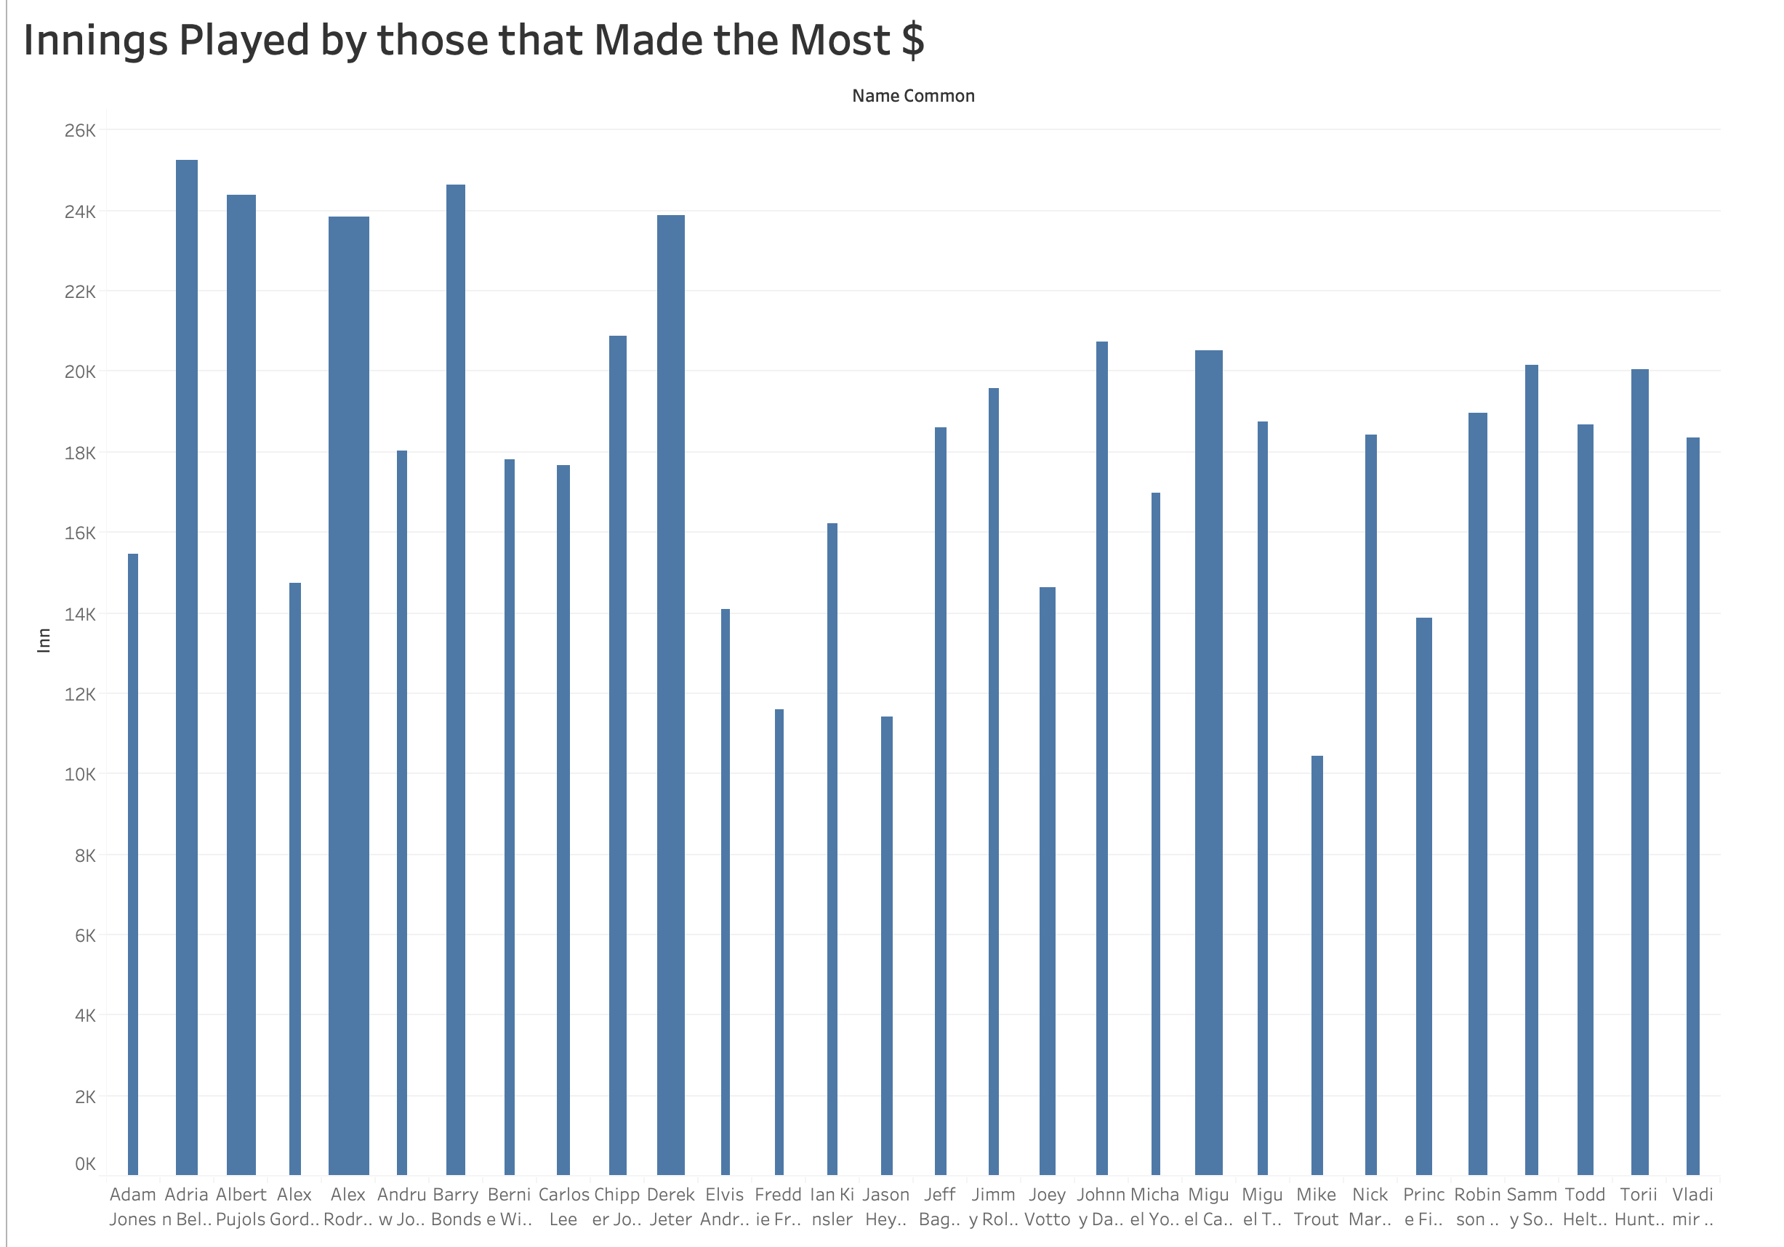
A look at playing time by total innings played during a players career.
Players shown are those that were top lifetime earners.
At min 10,000 innings played per player
They played a lot of innings!

Slide 31
Age and salary
After running a repeated measures ANOVA, we found that age had a significant impact on salary
Therefore, as a player ages, their salary changes also
These two factors go hand in hand throughout a players career

Slide 32
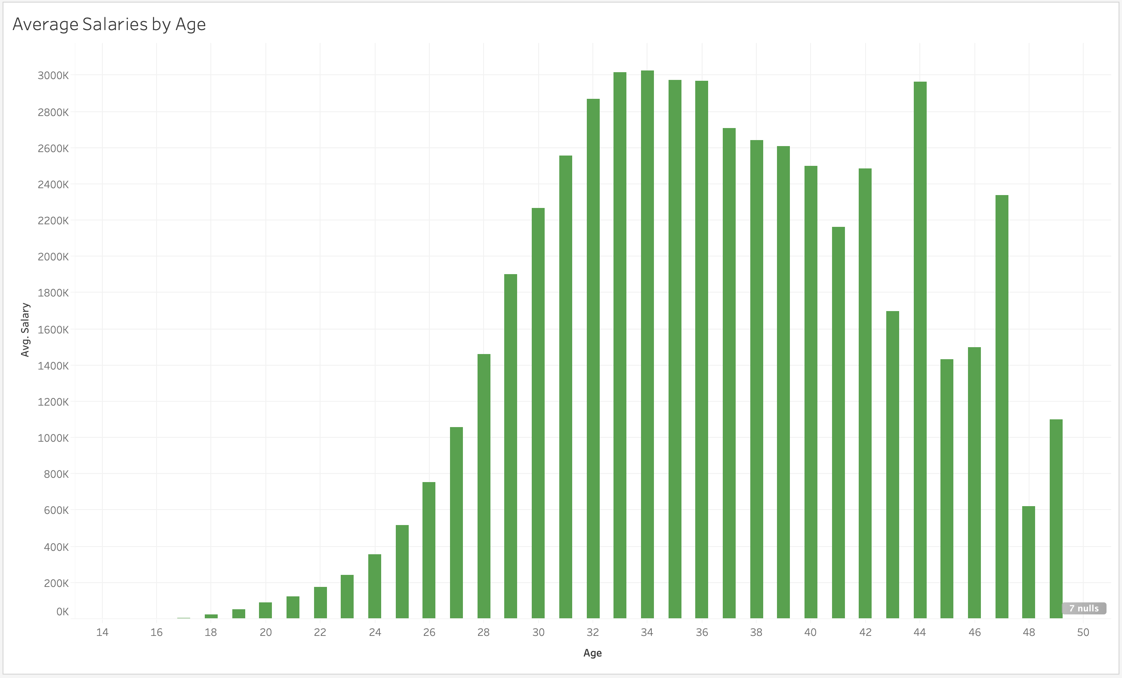

Slide 33
Correlation decrease
Age accounts for 55% of what determines salary from 1995-1999
This number drops to 36% between 2015-2019
One possible explanation:
A drop in average salary awarded to players in free agency

Slide 34
Problems with free Agency
This has been a concern sited by many commentators and industry experts
Difficult to prove due to rise in overall player salary
Still, a clear decrease in relationship between salary & players with 4+ WAR
signaling a decline in top talent receiving historically standard levels of compensation

Slide 35
Problems with free Agency
Fewer annual salaries above league average in 2015-2019
Despite having 1,000 more players with major league service time than 1995-1999
Also supported by 2019 decline in average salary
First in 10 seasons

Slide 36
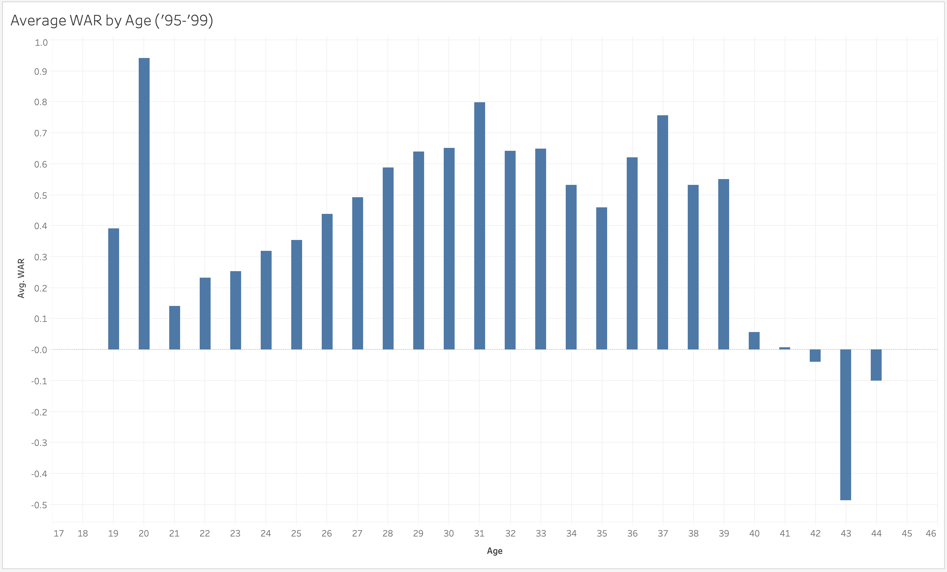
Higher WAR for players in late 20s, 30s

Slide 37
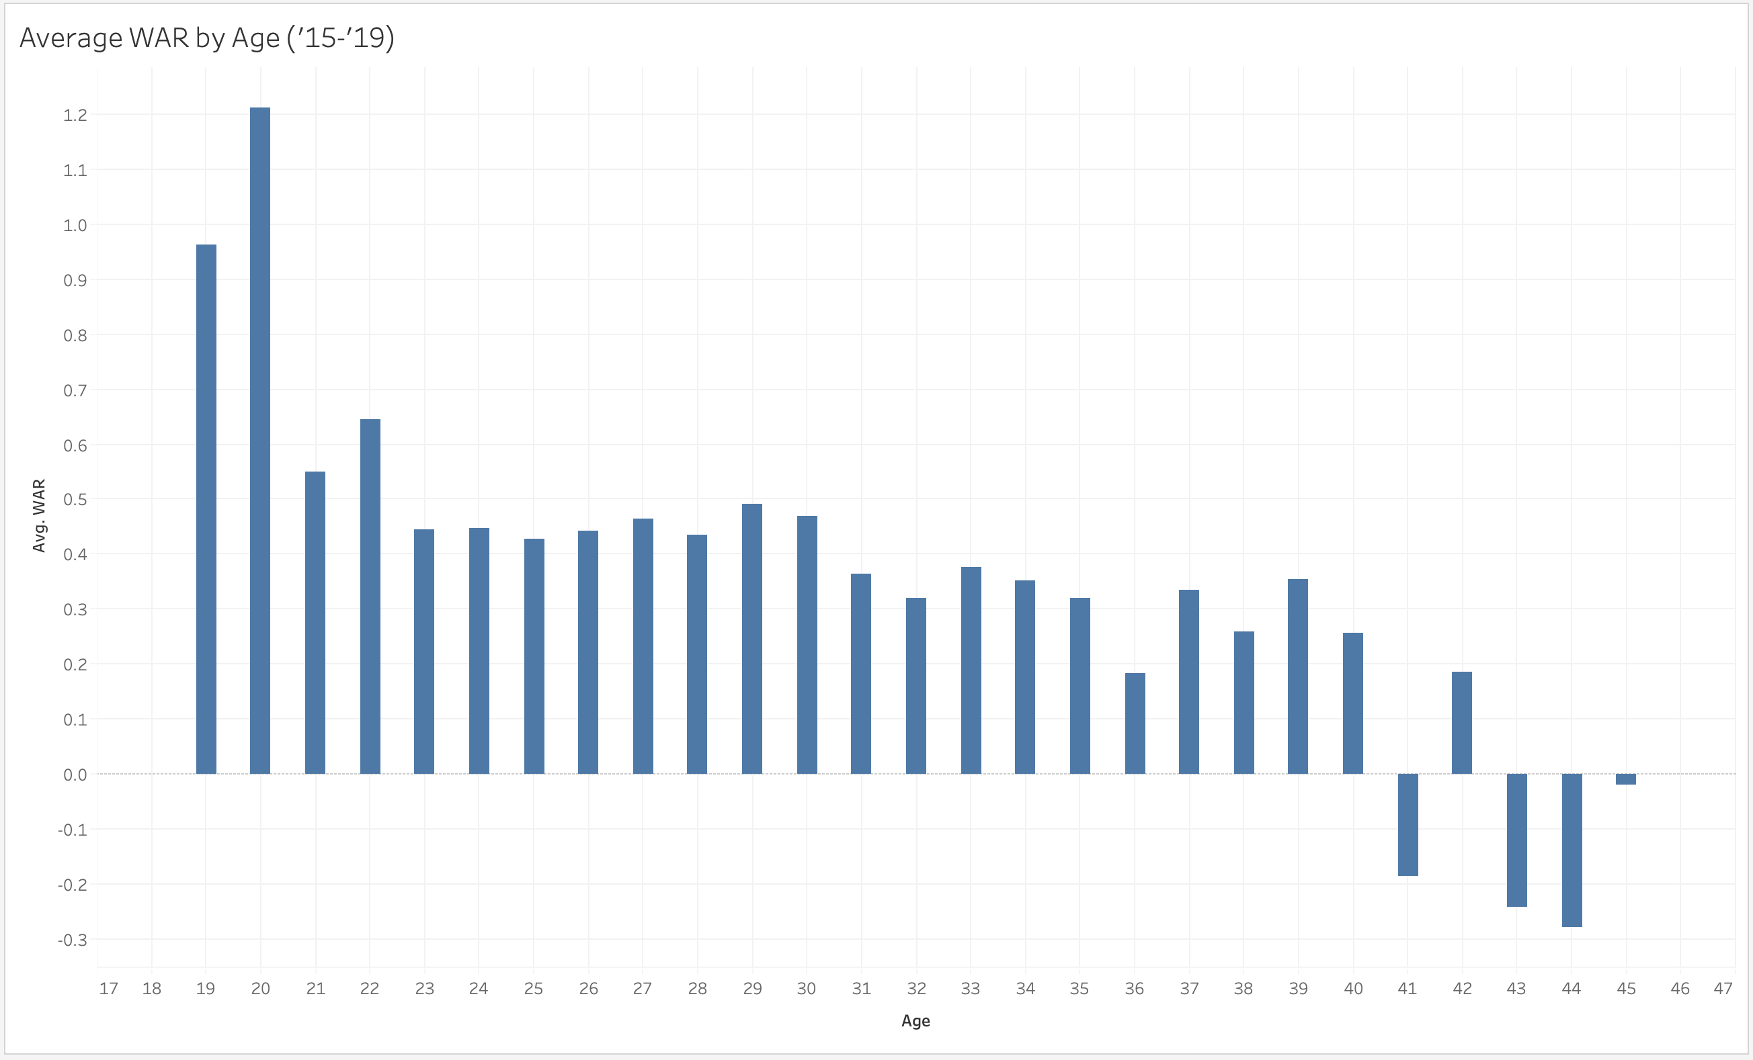
WAR higher in early 20s & lower in 30s, due to service time maximization?

Slide 38
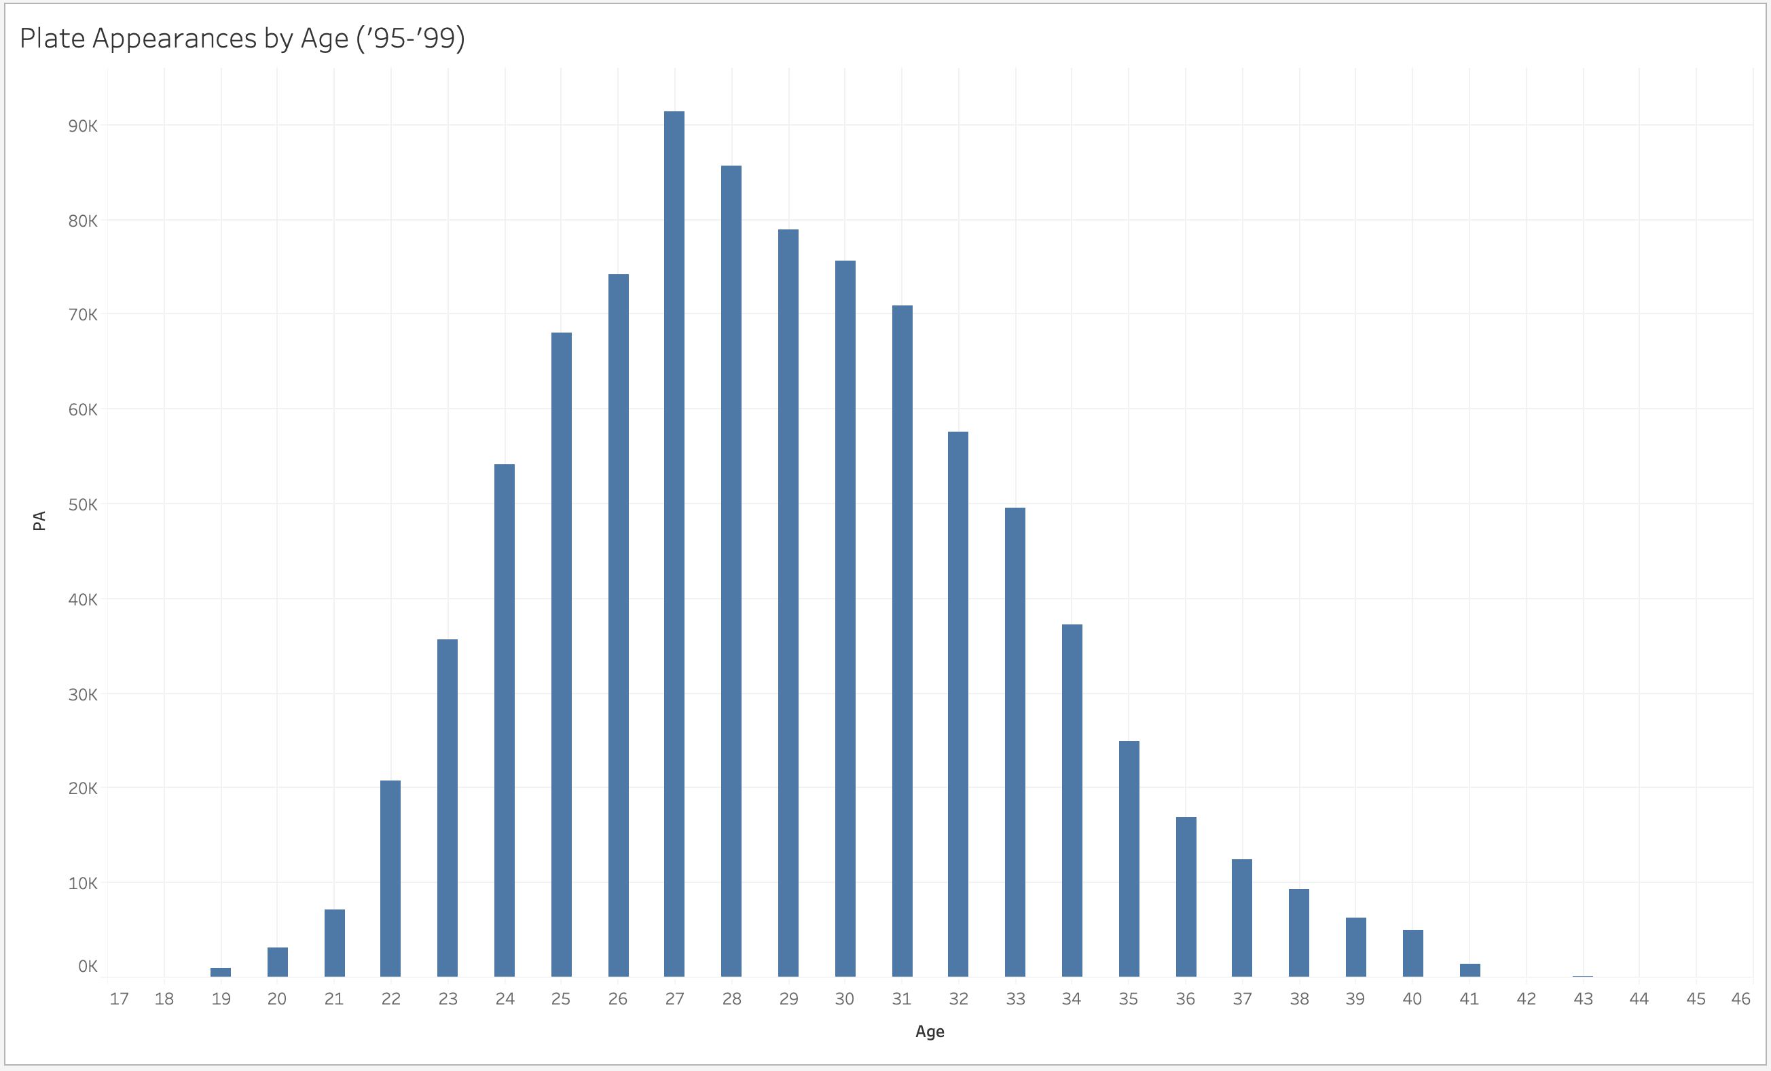
Higher PAs for players in late 20s, 30s

Slide 39
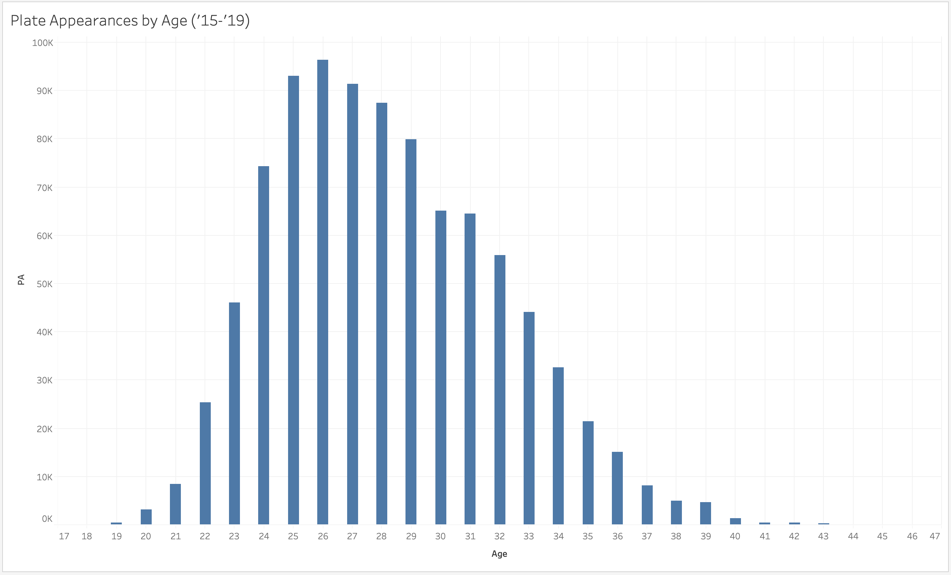
PAs make clear shift towards early 20s

Slide 40
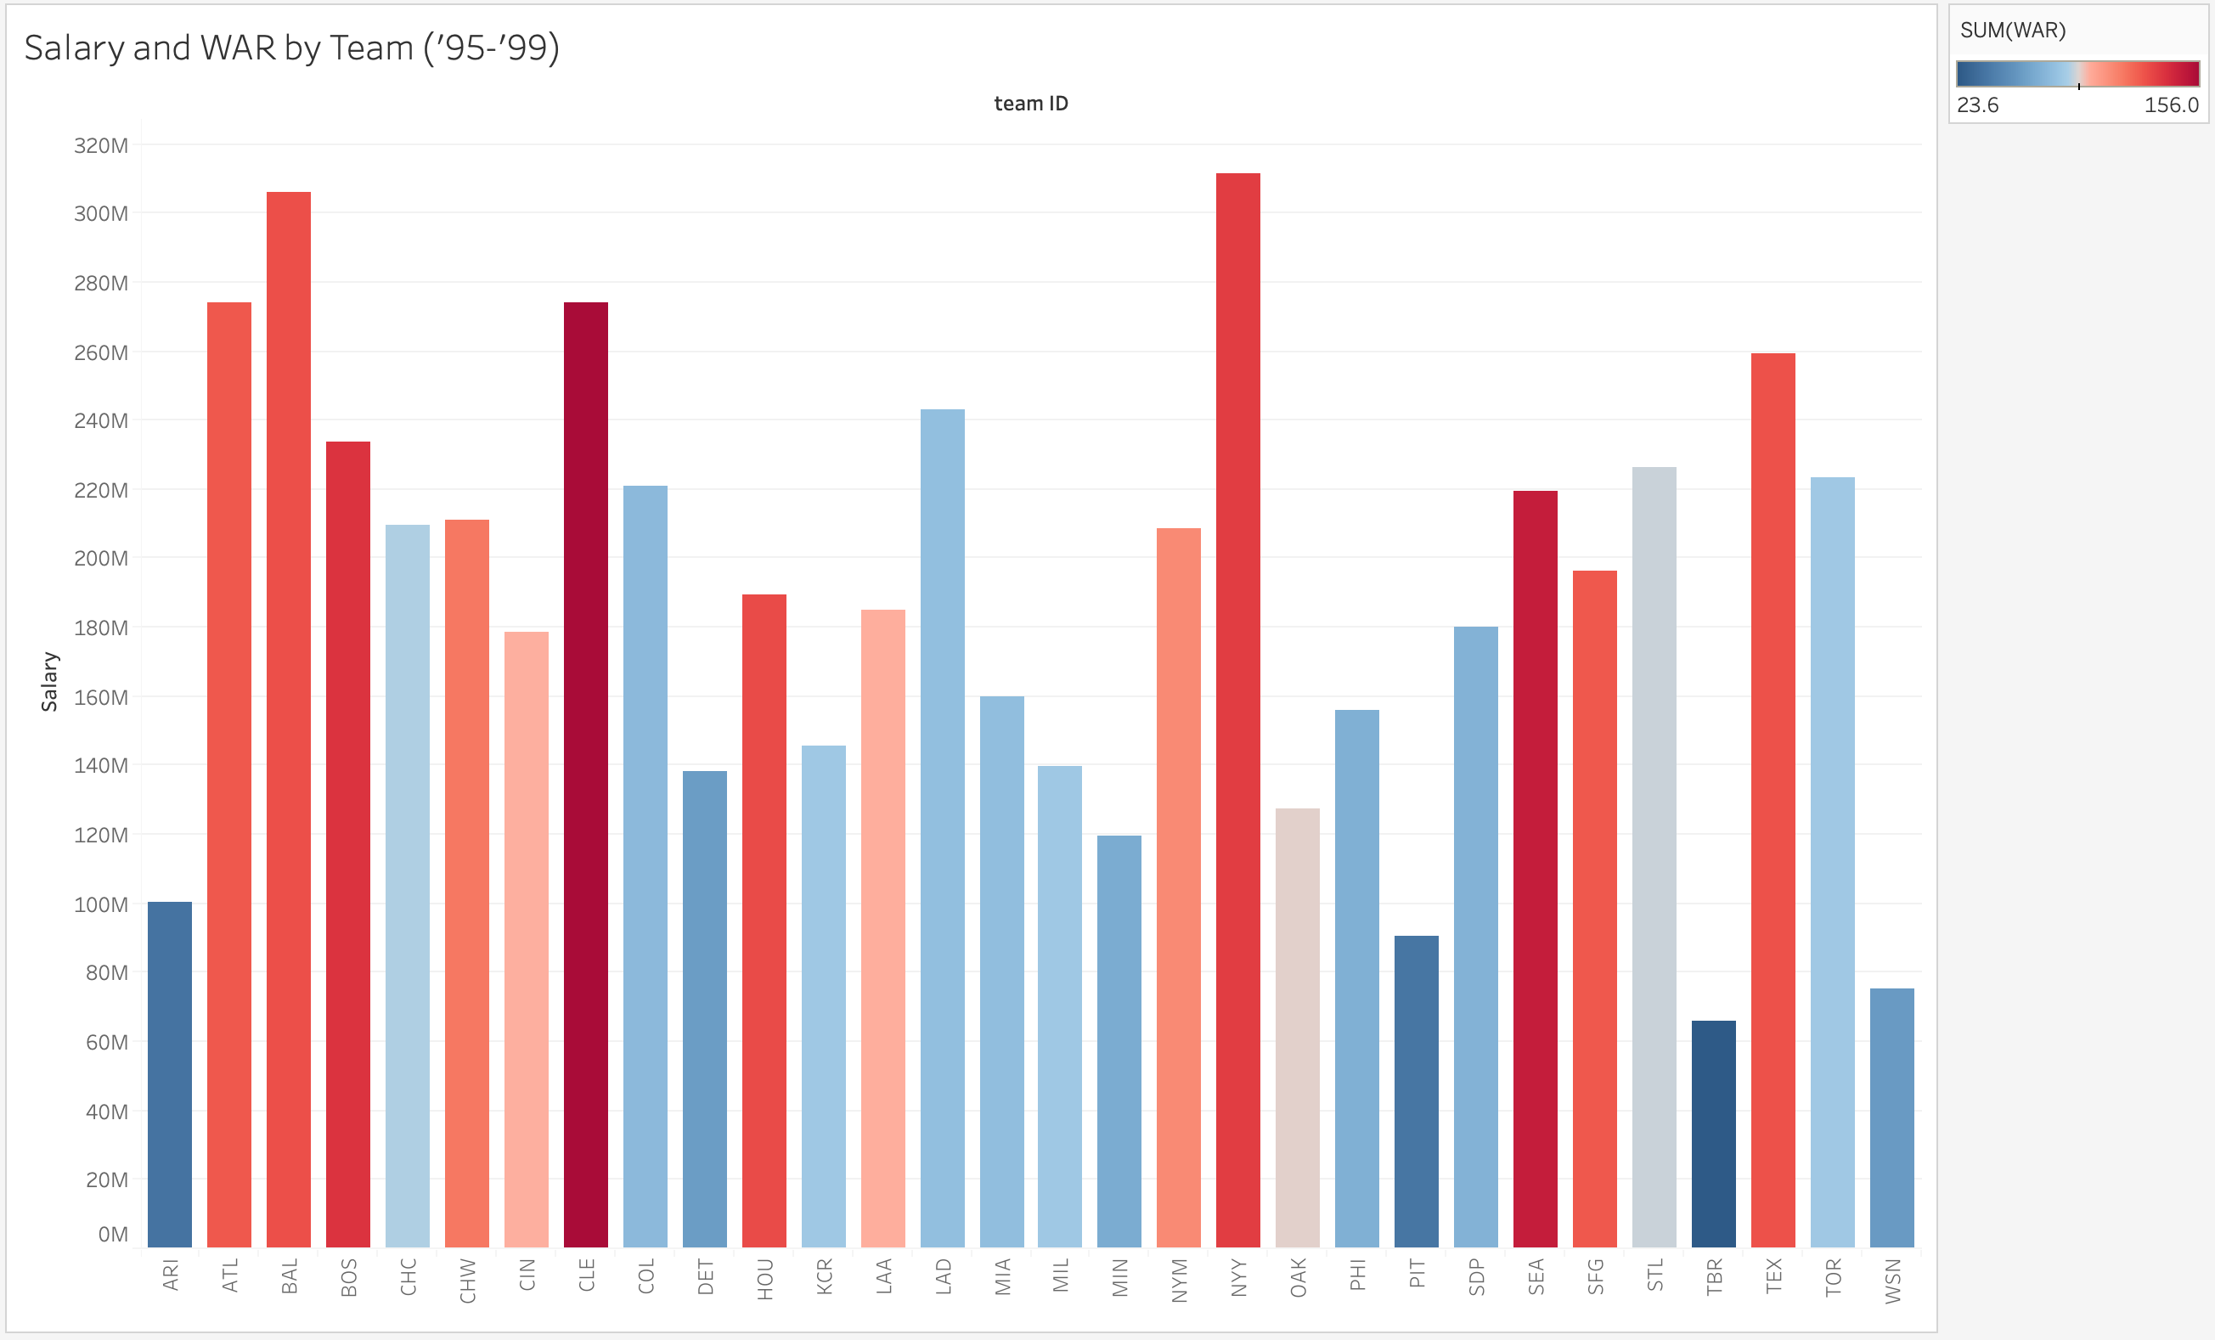

Slide 41
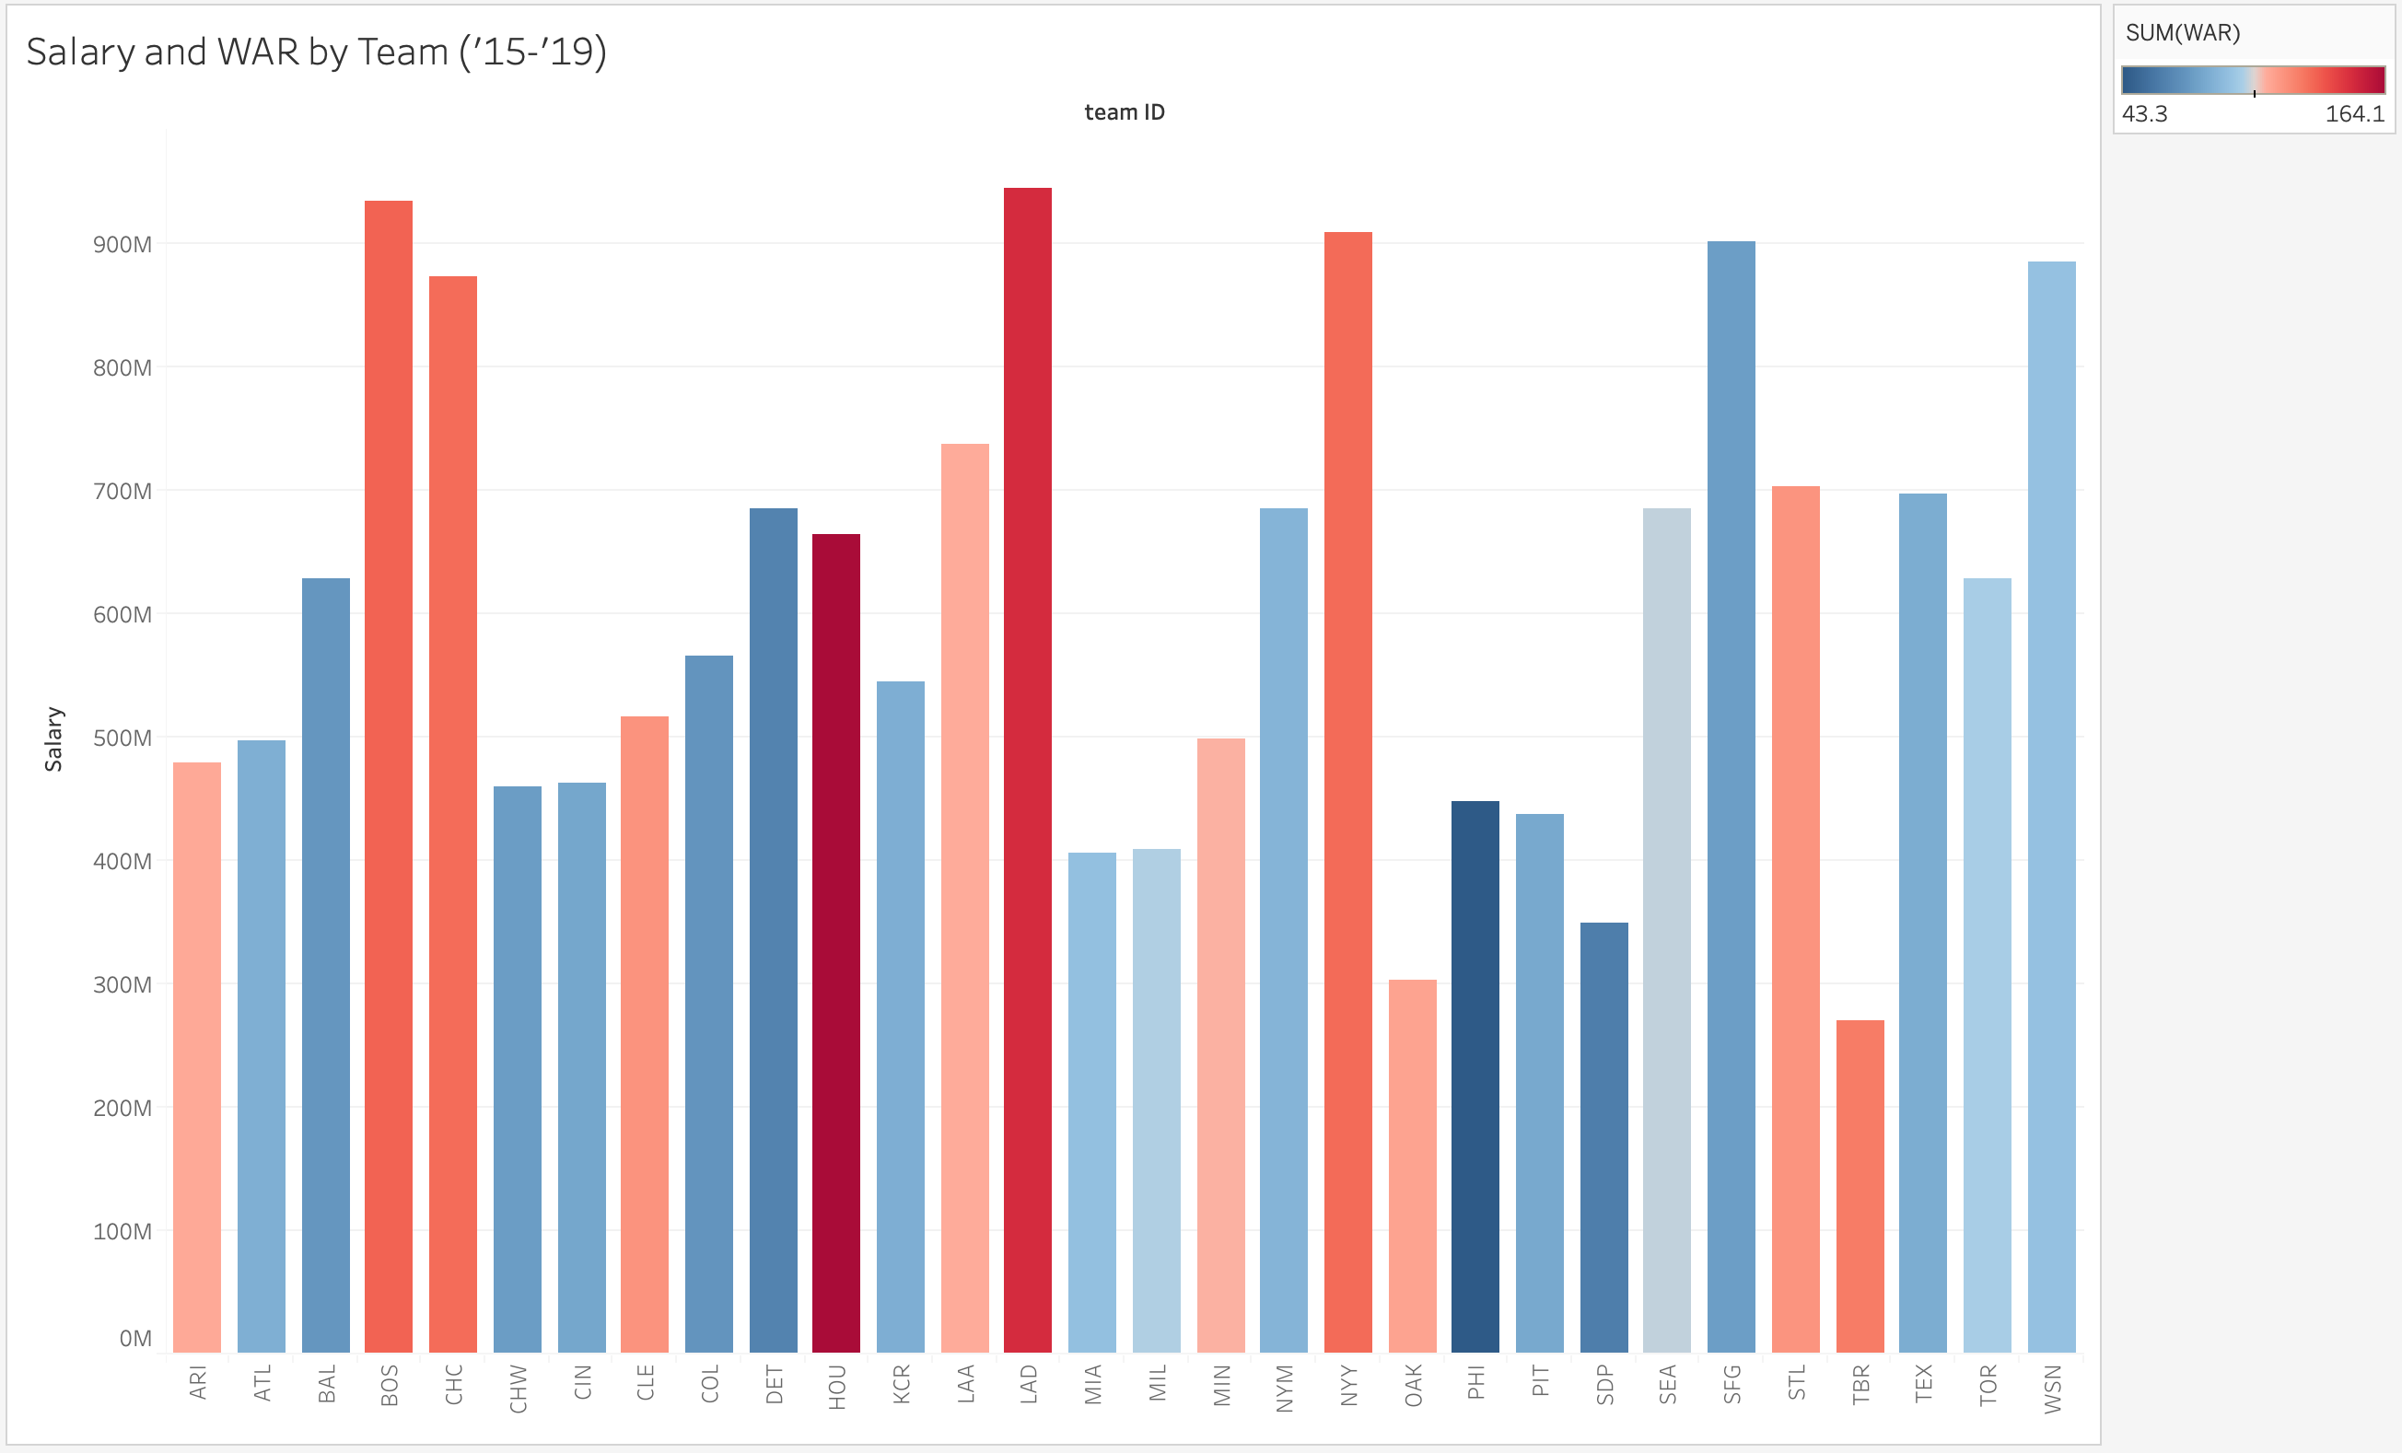

Slide 42
Summary
Teams are paying out higher salaries, but the average player is still not making the amounts they should based on their on-field play
Time and opportunities dictate a players earning power more than any other variable
One single season (or even a couple great seasons) will not necessarily mean a huge payday for a given player
Only consistently good play over time will have a significant impact on player salary

Slide 43
Conclusions
It appears that, instead of utilizing sabermetrics to pay deserving players more, teams have used these principles to save money by maximizing the use of players before they reach free agency
It’s difficult to definitively determine the cause of the significant change in salary over time which we identified
Potentially result of increased television revenue; we’d like more data on this
Further research could focus on how lengthy contracts and their terms impact potential earnings

Slide 44
Thanks for your time Questions?

